Slide 1
Using Credit Card Customers Dataset to Predict Churning Customers
Member: Wei Ruan
NUID: 001532991

Slide 2
1. Problem Statement
https://www.kaggle.com/sakshigoyal7/credit-card-customers?select=BankChurners
Managers at the bank are disturbed with more and more customers leaving their credit card services. They would really appreciate if one could predict for them who is gonna get churned so they can proactively go to the customer to provide them better services and turn customers‘ decisions in the opposite direction.
Objectives:
Building a workflow in any predictive modeling problem
Enhancing the predicting accuracy by adopting various methods

Slide 3
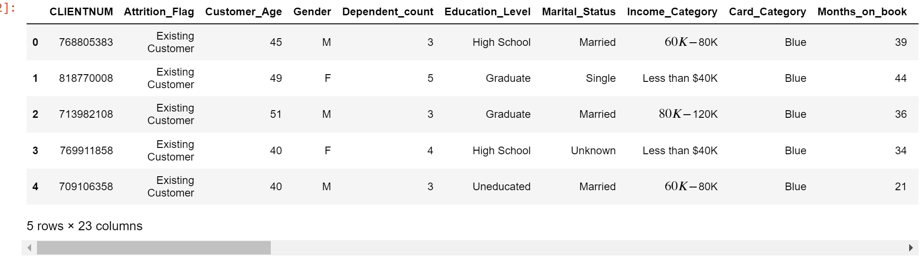
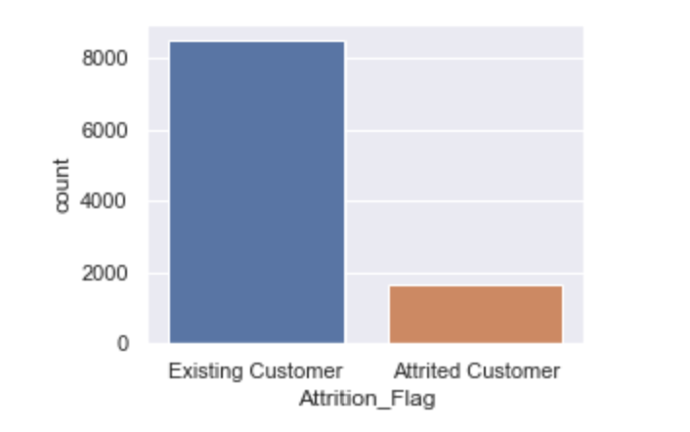
2. Data Source
https://www.kaggle.com/sakshigoyal7/credit-card-customers?select=BankChurners
The data come from Kaggle
Imbalanced data: Only 16.07% of customers who have churned
6 columns features including non-numerical features
Number of missing values :0
No redundant data

Slide 4
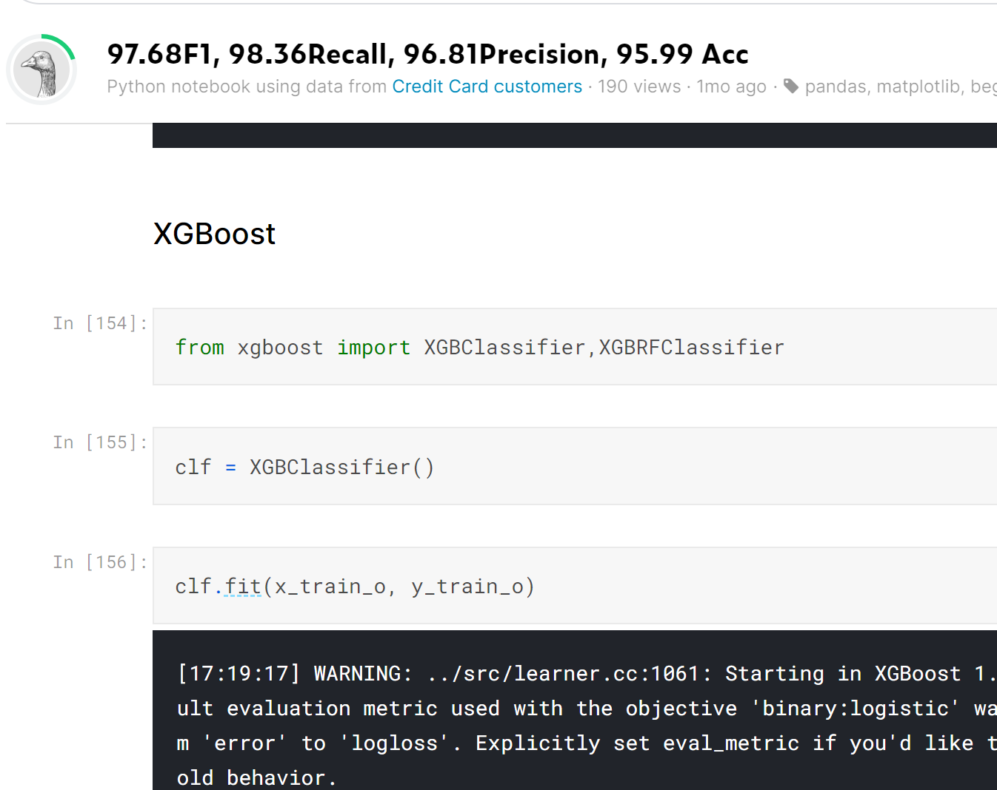
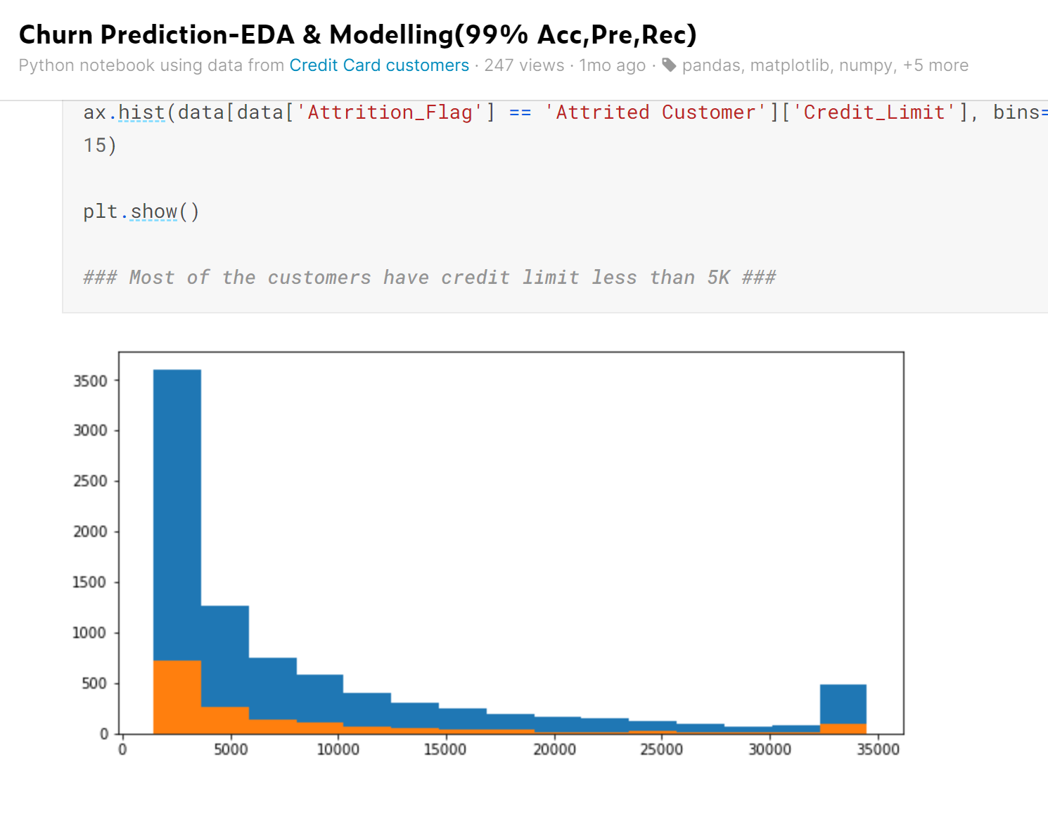
3. Existing solutions
Some scholars shared their outcomes on this project, the main methods including:
XGBClassifier
EvalML (AutoML)
Decomposition (PCA)
Logistic Regression
Support Vector Machine (SVM)
However, existing solutions lack detailed analysis for beginners from feature engineering to model choosing and model ensembling.

Slide 5
4. Ideas
How to do EDA（Exploratory Data Analysis）
How to pick up different Oversampling and Data Augmentation methods to deal with imbalanced dataset
How to choose better models
How to tuning hyper-parameters
How to ensemble model in order to get better results

Slide 6
5. Explain
Workflow
EDA（Exploratory Data Analysis）:no missing value, with text features, imbalanced data, etc.
Encoding: 6 columns label encoding
Heatmap: no redundant data and no dropping any features
Data Scaling and Standardization: standardizing data
Splitting: train set:0.75, test set:0.25
Oversampling and Data Augmentation: using random oversampling, SMOTE and Boderline-SMOTE respectively. The results show SMOTE and Boderline-SMOTE are superior to random oversampling.
Models choosing:
Kneighbors, Decision Tree , Random Forest and Neural Network(MLPClassifier)
RandomForest model shows higher accuracy.
Hyperparameter tunning for best models: max_depth=9, max_features=16, n_estimators=114
Ensemble modeling:
Voting Classifier: RandomForest, DecisionTree, Neural Network(MLPClassifier)

Slide 7
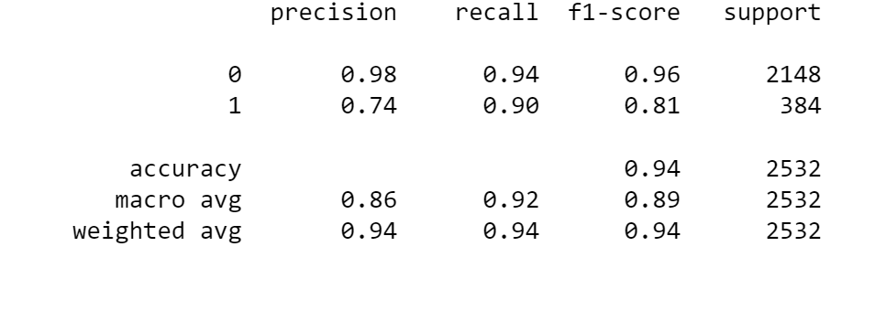
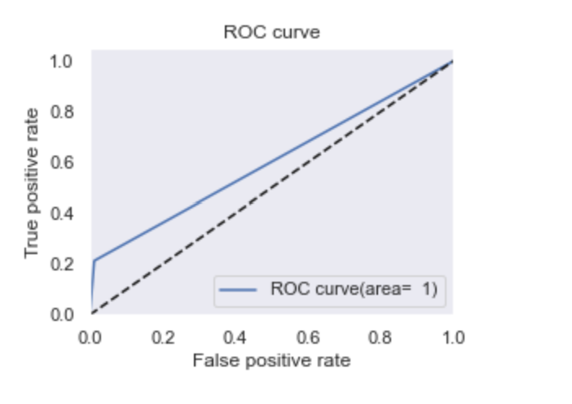
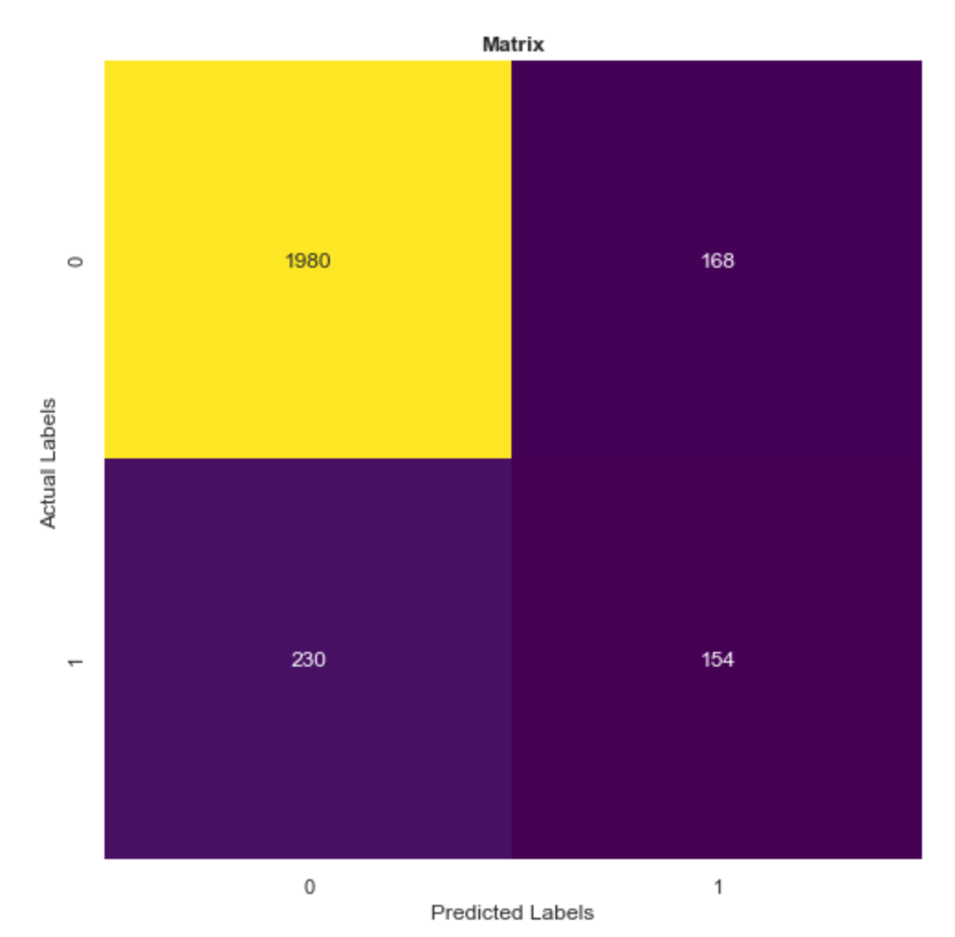
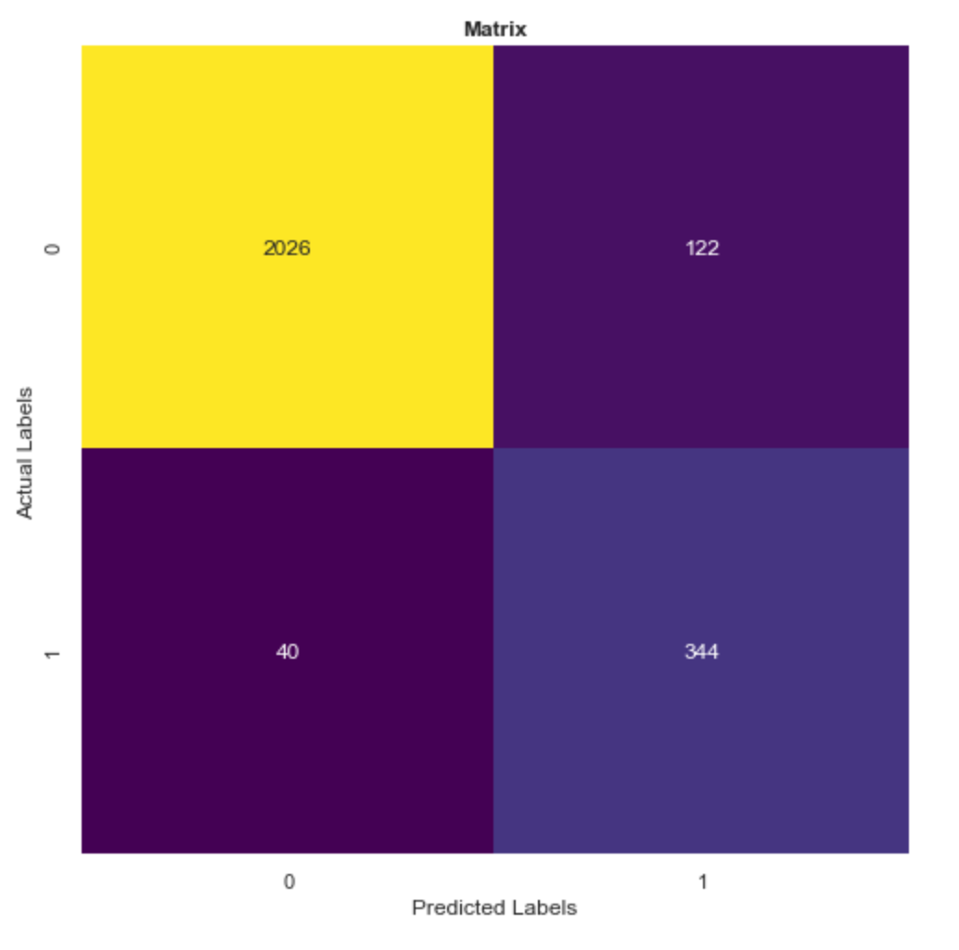
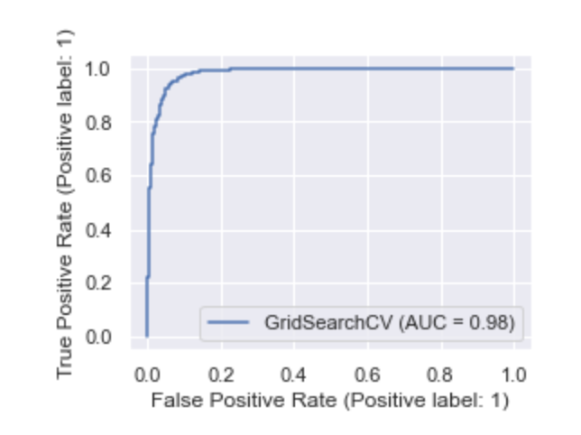
6. Results
Preliminary accuracy: 87%
Finial accuracy: 94%
Preliminary ROC, AUC: 0.60
Preliminary Confusion Matrix
Finial Confusion Matrix
Finial ROC, AUC:0.98

Slide 8
7. Future Scope
Conducting feature engineering and trying to build more models and tune Hyperparameters of them, and finally ensembling them:
Performing feature engineering aiming to satisfy each model.
Models including:
SVM, XGB, DNN, CNN, Naive Bayesian, Logistic Regression,
PCA, Ridge Regression, Lasso Regression, Bayesian Linear Regression,
k-means, etc.
Ensemble modeling:
Try to combine various models by different methods to acquire better results.

Slide 9
8. References
Alice Zheng, Amanda Casari, Feature Engineering for Machine Learning;,2018, Publisher(s): O'Reilly Media
Mehryar Mohri, Afshin Rostamizadeh, and Ameet Talwalkar. Foundations of Machine Learning. MIT Press, 2012.
Rudolph Russell, Machine Learning: Step-by-Step Guide To Implement Machine Learning Algorithms with Python , 2018
Bruce Ratner, Statistical and Machine-Learning Data Mining: Techniques for Better Predictive Modeling and Analysis of Big Data, Third Edition

